Slide 1
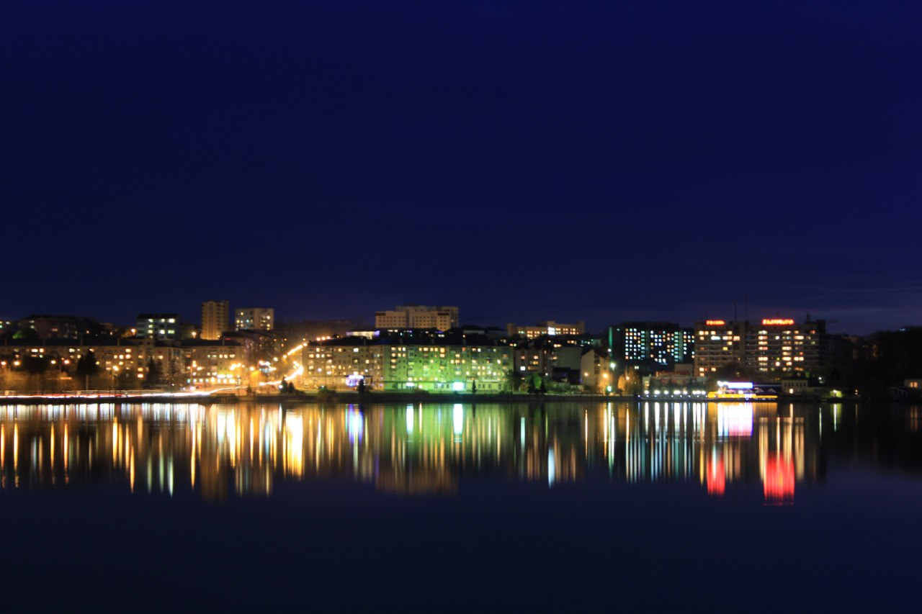
TERNOPIL
INVESTMENT POTENTIAL

Slide 4
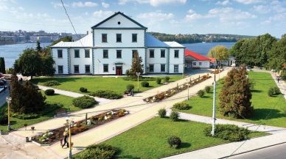
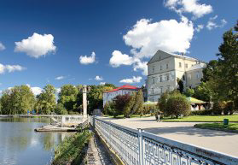
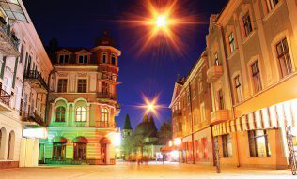
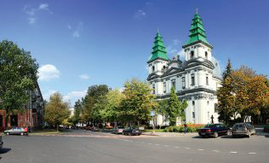
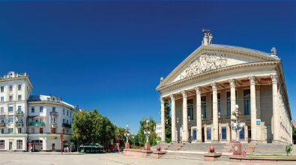
Ternopil in Europe
St. Petersburg
Moscow
Minsk
London
Warsaw
Kyiv
Berlin
Ternopil
Vienna
Paris
T”bilisi
Zurich
Ankara
Rome

Slide 5
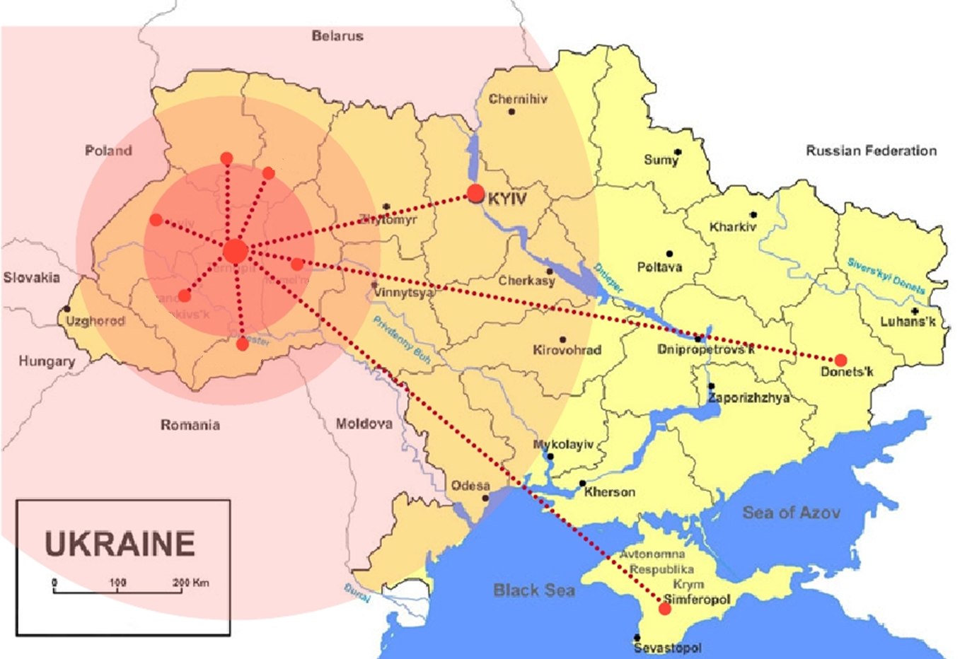
Ternopil in Ukraine

Slide 6
Ternopil
Geographical center of Western Ukraine situated at the intersection of trade and transportation routes from South to North and from East to West
Population of the city - 217 thousand people
Area – 5 800 hectares
Adjacent to the six regional centers of Ukraine
A transportation hub of railway and motor transport

Slide 7
Five advantages of the city
1. Advantageous trans-European location Roads E50 and E85 cross the city Only 200 km to the EU border
2. Strong tourism potential
3. Clean environment with urban, coastal and
forest landscapes
4. Unique recreational potential
5. Favorable investment climate

Slide 8
Recognition and Awards
1.Ternopil was awarded with the Diploma of Council of Europe for active promotion of the European ideal (23.04.2013)
2.Ternopil received the Flag of Honour of the Council of Europe for propagation of understanding between the people of Europe (10.04.2014)
3. Ternopil was awarded with the Plaque of Honour of the Council of Europe as recognition of the city endeavors in spreading the idea of European unity (21.04. 2015)

Slide 9
Recognition and Awards
4. Ternopil ranked first among the cities with a population of less than 250 thousand people in the category “Business Efficiency” of the Investment rating of “European Cities and Regions of the Future 2012-2013, 2014-2015” Contest conducted by «fDi Magazine Financial Times».
5. Ternopil City Council (administrative services) implemented a Quality System and received a certificate ISO 9001

Slide 10
Recognition and Awards
6. Ternopil is among the five most prosperous cities of Ukraine (according to the data of State Statistics Service 2013)
7. In the ranking of the most cultural cities of Ukraine Ternopil ranked 9th among 73 cities*
8. First place in the rating of the most educated cities of Ukraine
9. In the ranking of the healthiest cities Ternopil ranked 8th on indicators of population health*
* as part of the “Best cities to live in Ukraine" project, "Focus" magazine, 2012.

Slide 11
TERNOPIL- THE BEST CITY FOR YOUR INVESTMENT
Favorable geographical location
High natural potential
Highly-educated human resources
Low cost of working time
Fast and transparent licensing
Availability of stocking and production areas
Full support of the investor by the municipality
Environmentally clean region
Prices, taxes, property maintenance costs and wages are much lower than in large cities

Slide 12
City economy
The volume of realized industrial products is
315 mln USD
Foreign trade turnover is 200 mln USD
Foreign direct investments are 15 mln USD
Over the past year, industrial production has
increased by 18 %.
Perspective industrial potential of the city with 170
operative enterprises, among which 120 large
enterprises.

Slide 13
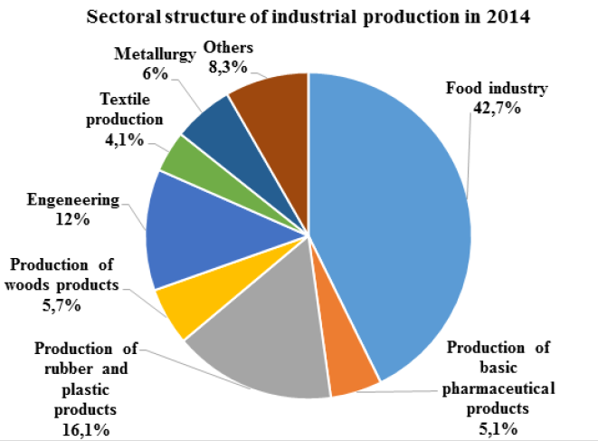

Slide 15
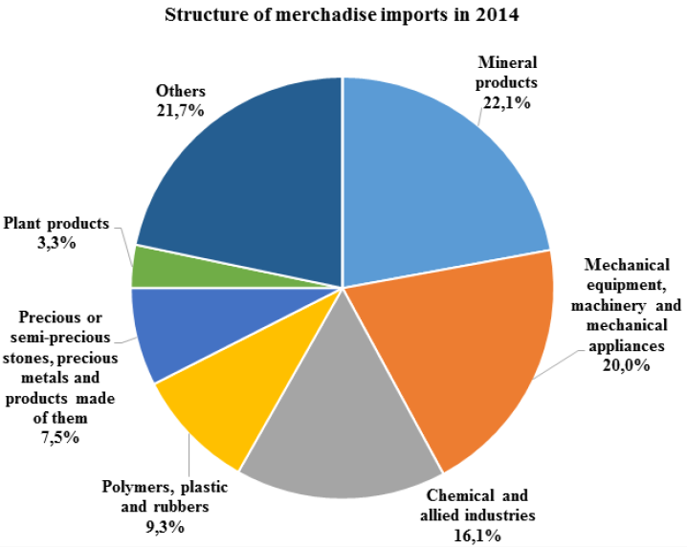

Slide 16
Main countries – investors
Investments come from 34 countries of the world.
The five major countries - investors accounting for 79.7% of total direct investment:
1. Estonia
2. Poland
3. Belgium
4. Cyprus
5. Germany

Slide 17
Key Enterprises
LLC VATRA Corporation
AGATA Steel Construction
LLC SHREDER
JSC VINITEKS
LLC Ternopil Furniture Factory
LLS VINISAN
JSC Radio Plant ORION
LLC HALIYA
JSC TerA
LLC TEKSTERNO
LLC TERNOBUD Plus

Slide 18
Key Enterprises
LLS HALYCHYNA LASUNKA
LLC TERNOPILBUD
LLC CREATOR BUD
JSC Ternopil MILK PLANT
Ternopil door factory WOOD WAY
LLC Ternopil brewery OPILLIA
LLC SAYUZ
LLS TERVIKNOPLAST

Slide 19
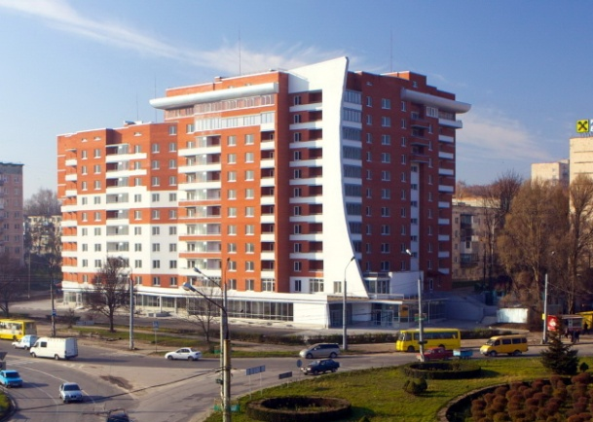
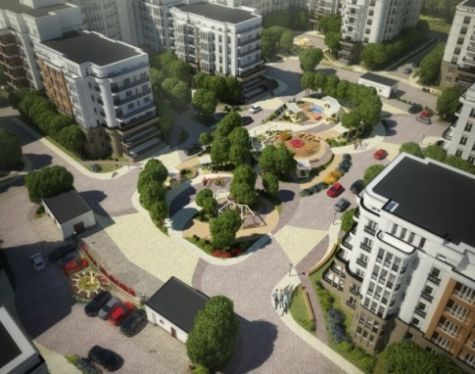
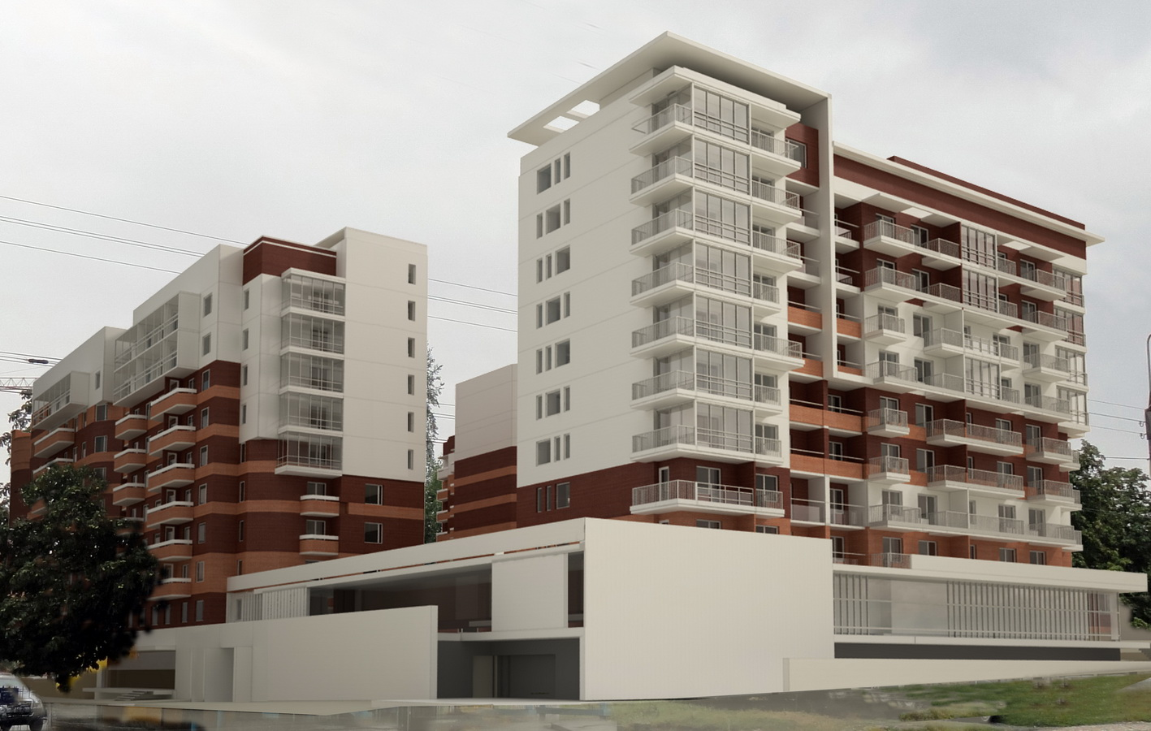
Active City Development

Slide 20
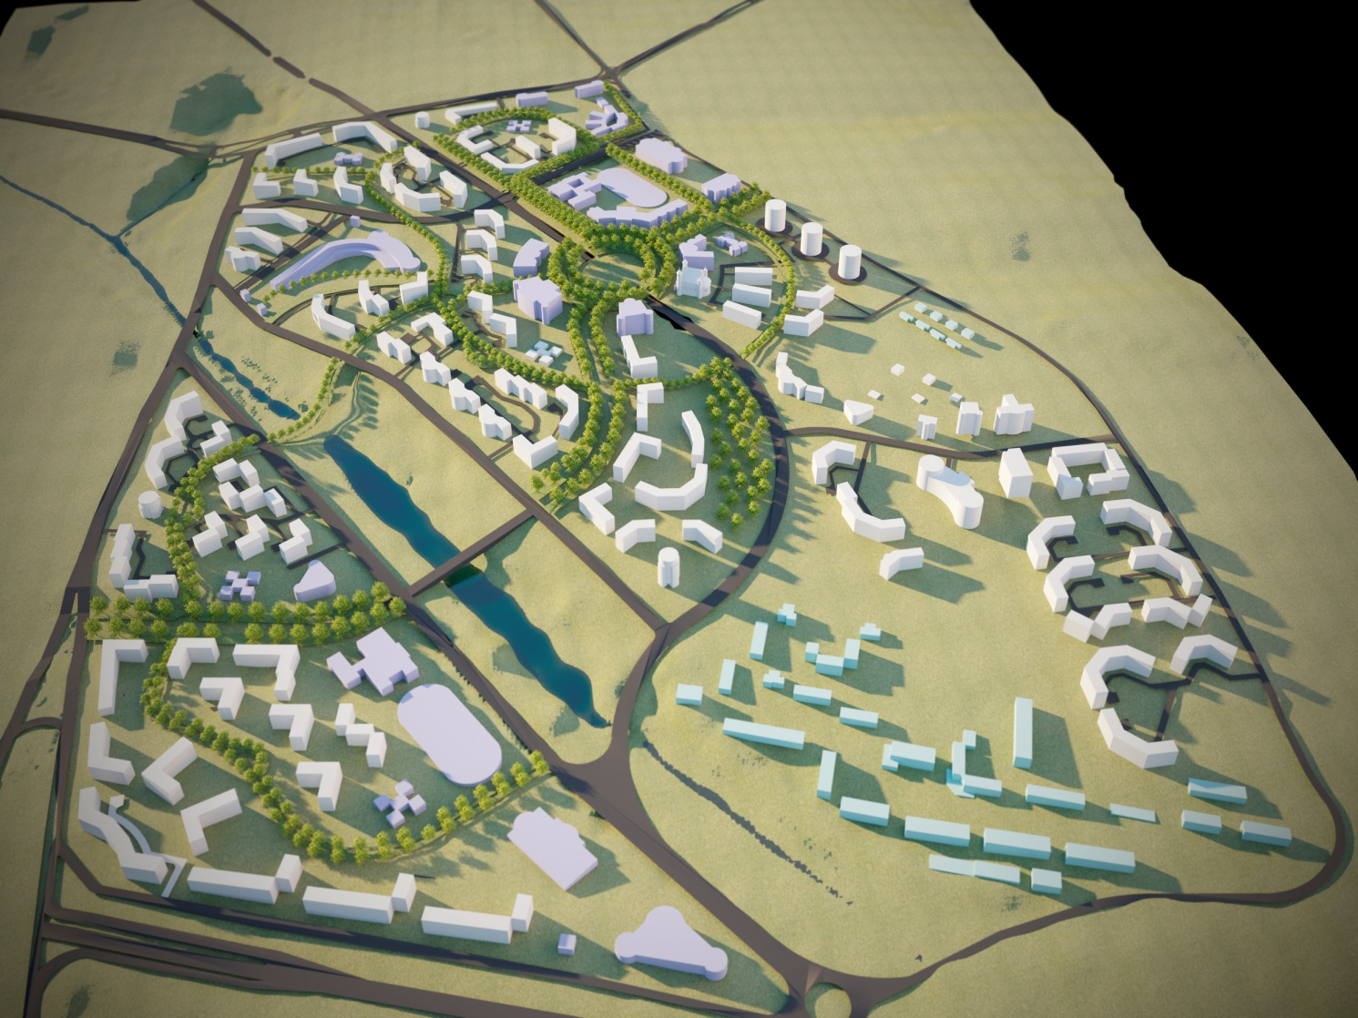
The new microdistrict Kutkivtsi

Slide 21
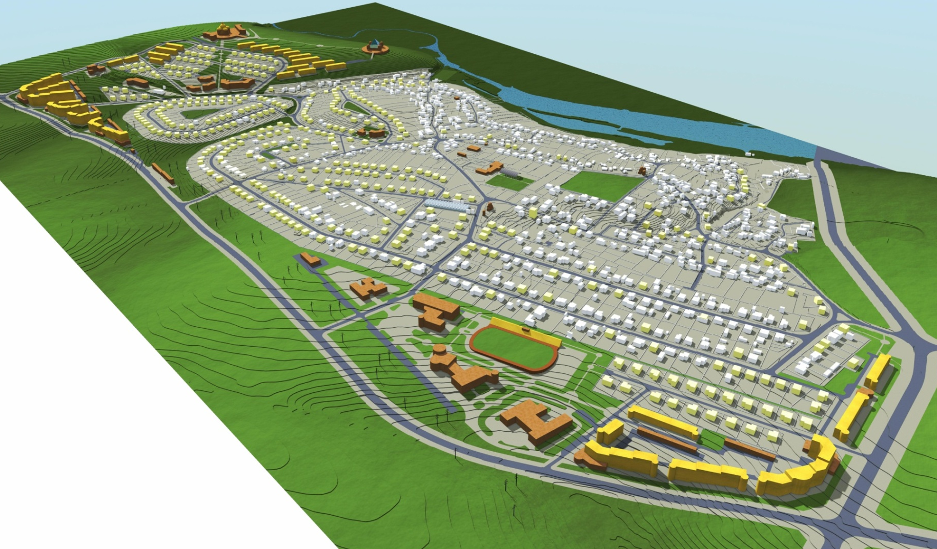
The new microdistrict Proniatyn

Slide 22
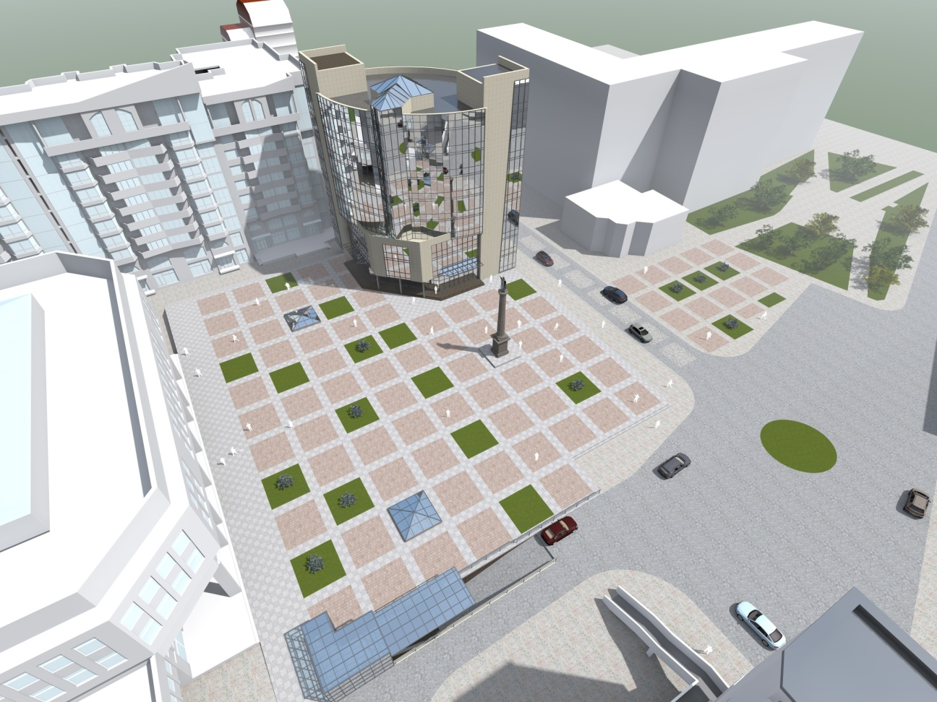
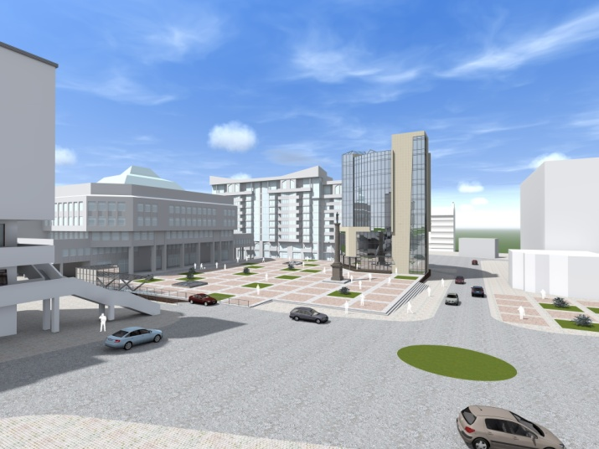
Euromaidan Heroes Square

Slide 23
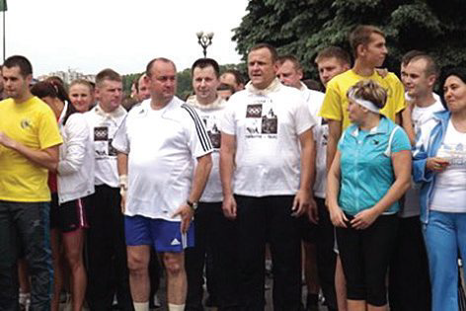
Ternopil – Students Capital
11 INSTITUTIONS OF HIGHER EDUCATION
OVER 35 THOUTHAND STUDENTS
OVER 4 THOUTHAND FOREIGN STUDENTS
FAVOURABLE MULTICULTURAL ENVIRONMENT
ACTIVE INTERNATIONAL COOPERATION

Slide 24
Ternopil – Students Capital

Slide 25
Ternopil – IT Centre
Ternopil universities actively cooperate with the leading IT companies within the programs of IEEE, IBM Academic Initiative, Cisco Networking Academy, Oracle Academy and others.
IT companies of Ternopil organize courses for citizens, for example the IT Academy ELEKS.

Slide 26
IT Projects in Ternopil
GPS-monitoring of public transport
School electronic security system
Open city
City video monitoring

Slide 27
Ternopil – IT Centre
In the short term outcome we see the formation of effective labour market in Ternopil, particularly in the IT industry.
In the long term outcomes the large IT companies will enter the city that can offer more jobs with competitive salaries and improve research departments of universities, open R&D laboratories.

Slide 28
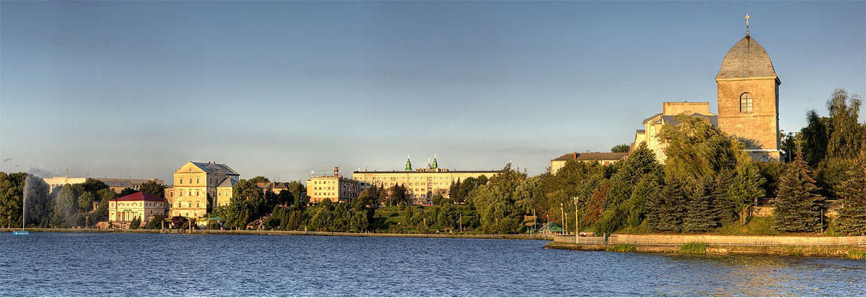
Ternopil Lake
Location in the centre of the city
Area 300 hа
Formed on Seret river
Transport Yachts, motor boats, scooters
Certificated by European Federation of Powerboat Sports to hold International competitions

Slide 29
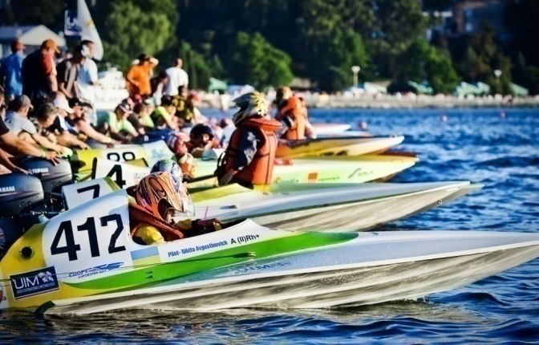
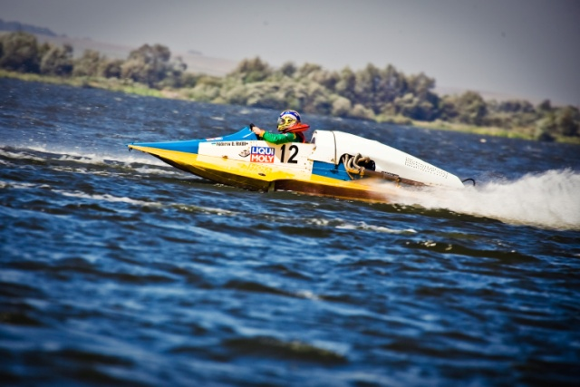
In 2011-2015 the Powerboat World and European Championships were held on Ternopil Lake

Slide 30
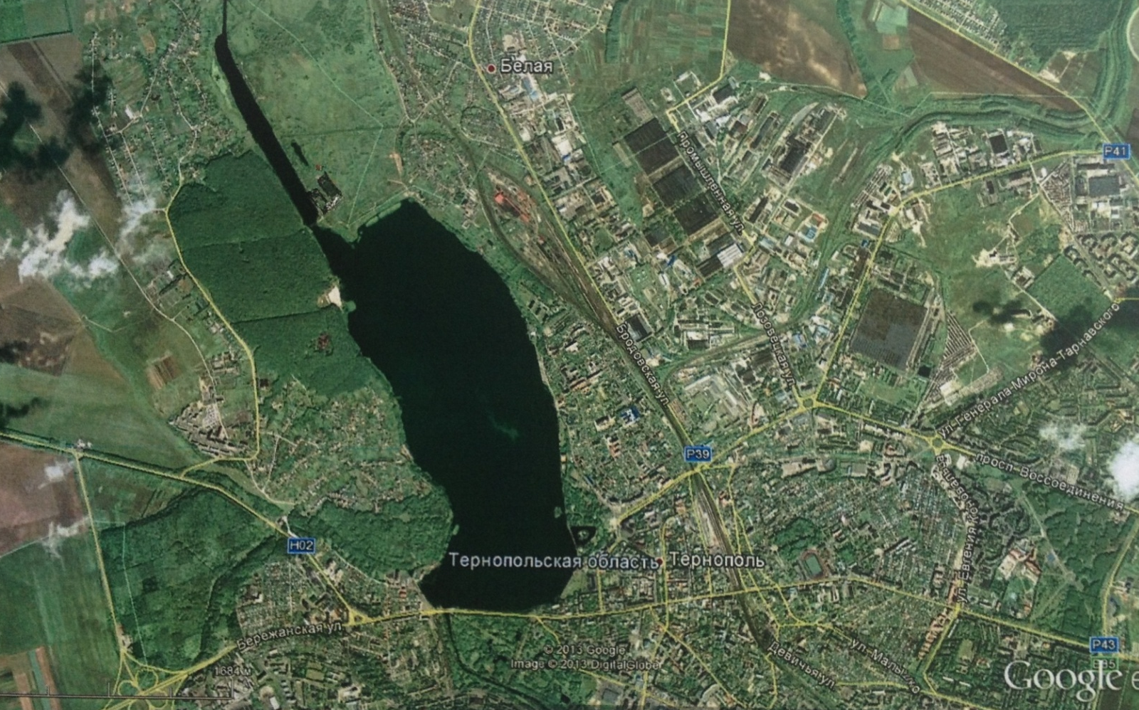
Rowing Channel Reconstruction

Slide 31
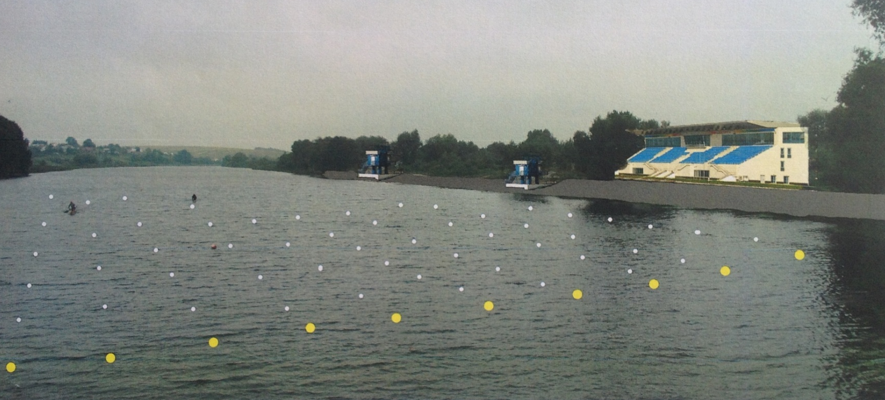
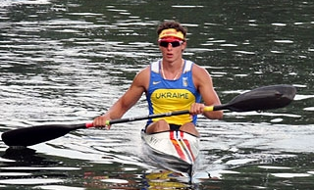
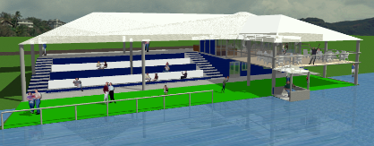
Rowing Channel Reconstruction

Slide 32
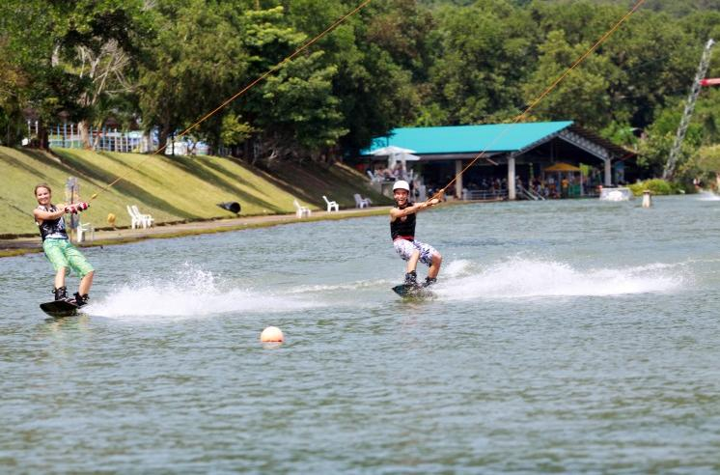
Rowing Channel Reconstruction

Slide 33
YACHT CLUB and SPORTS FACILITIES

Slide 34
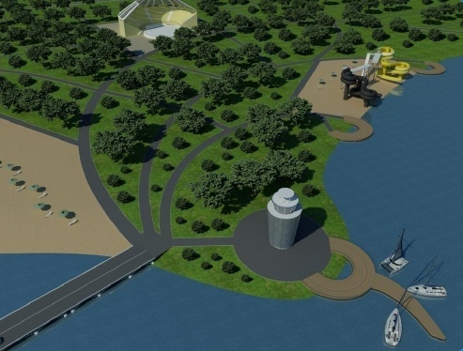
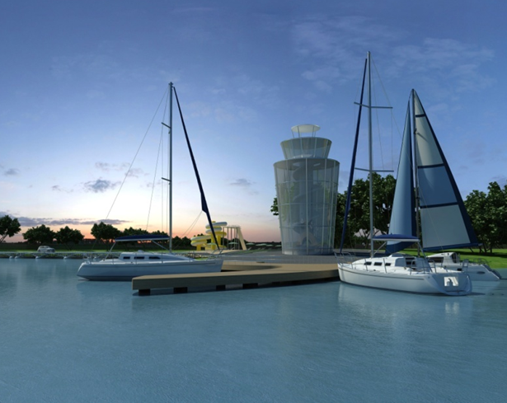
Leisure and Recreation complex Lake and Parks
We plan to create a place for families to spend leisure time and to lay out parks of Disneyland type

Slide 35
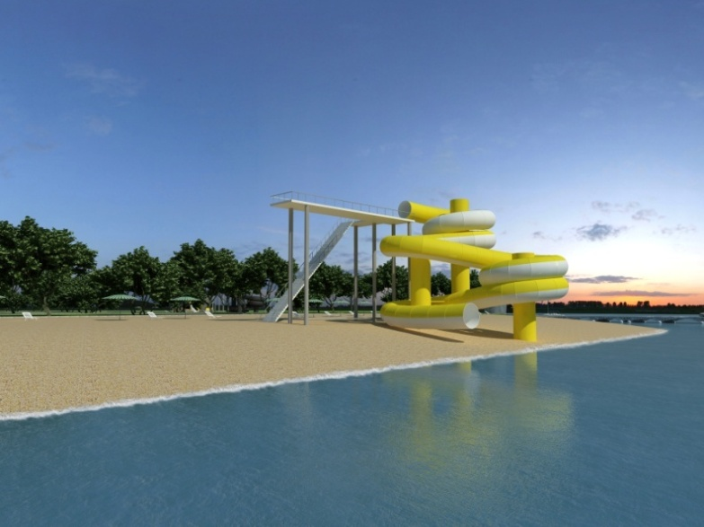
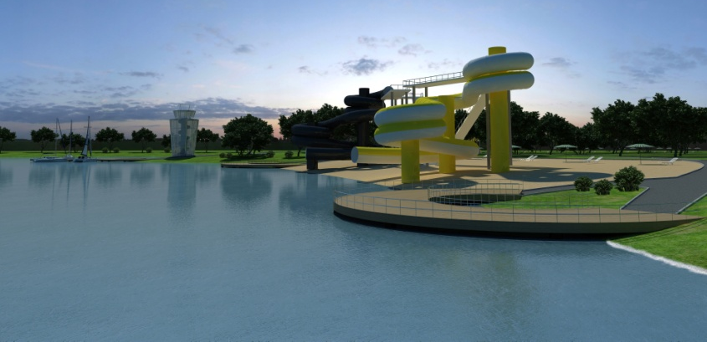

Slide 36
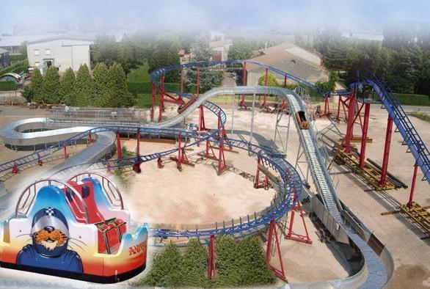
Construction of Disneyland Amusement Park

Slide 37
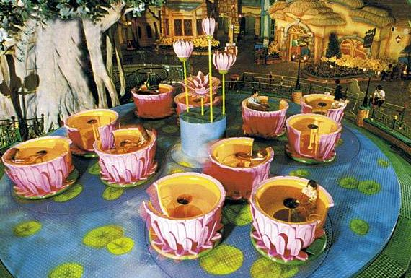
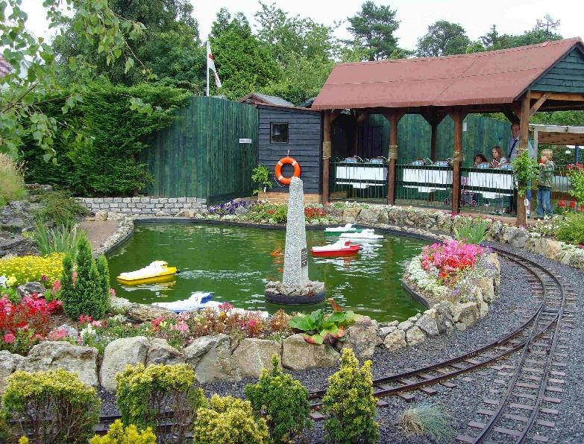
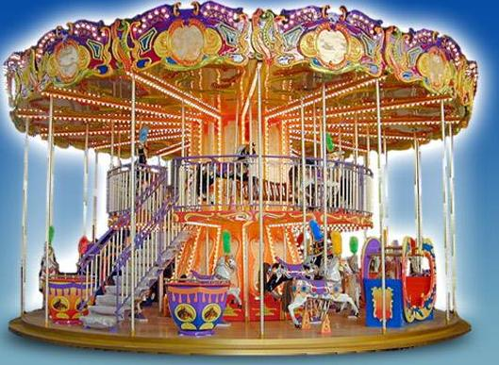

Slide 38
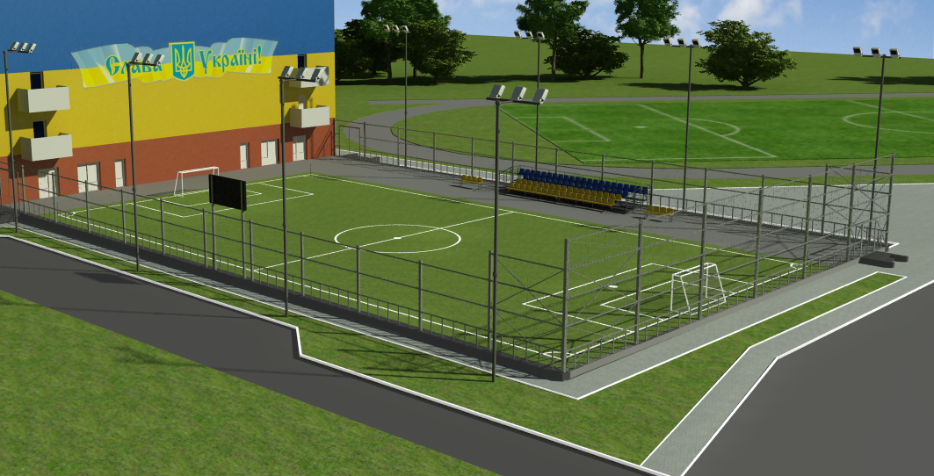
Development of Topilche Park
Construction of an Artificial Turf football field

Slide 39
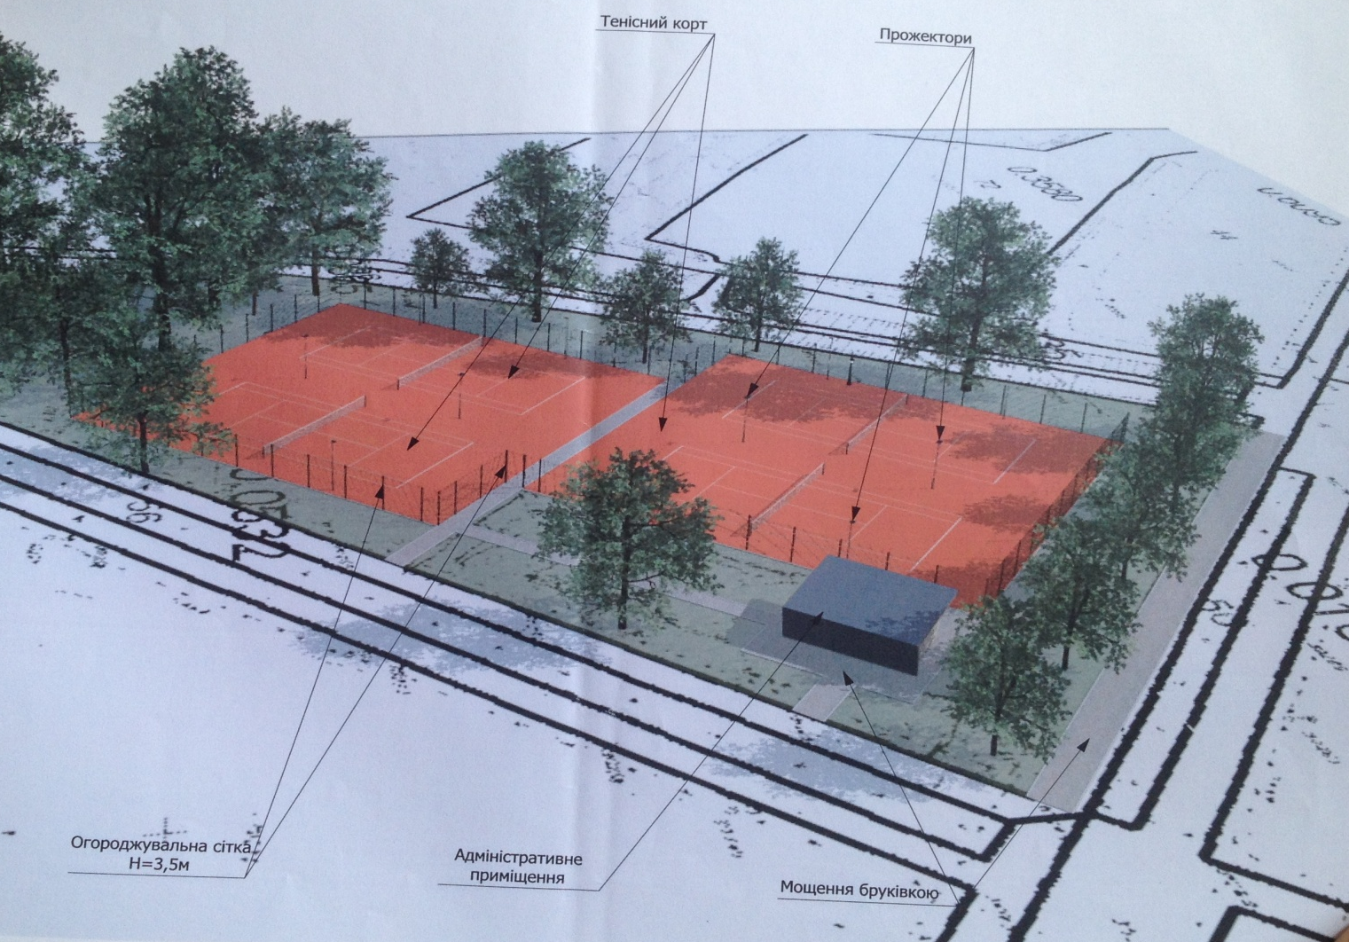
Construction of outdoor tennis courts

Slide 40
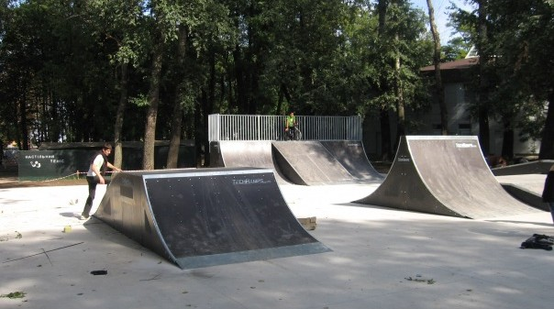
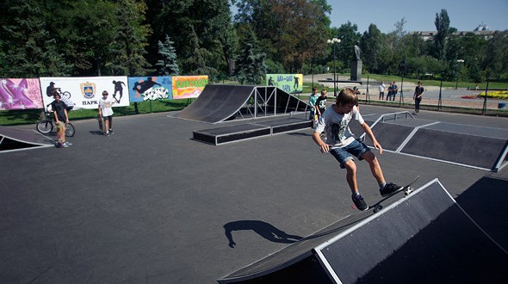
Skatepark construction

Slide 41
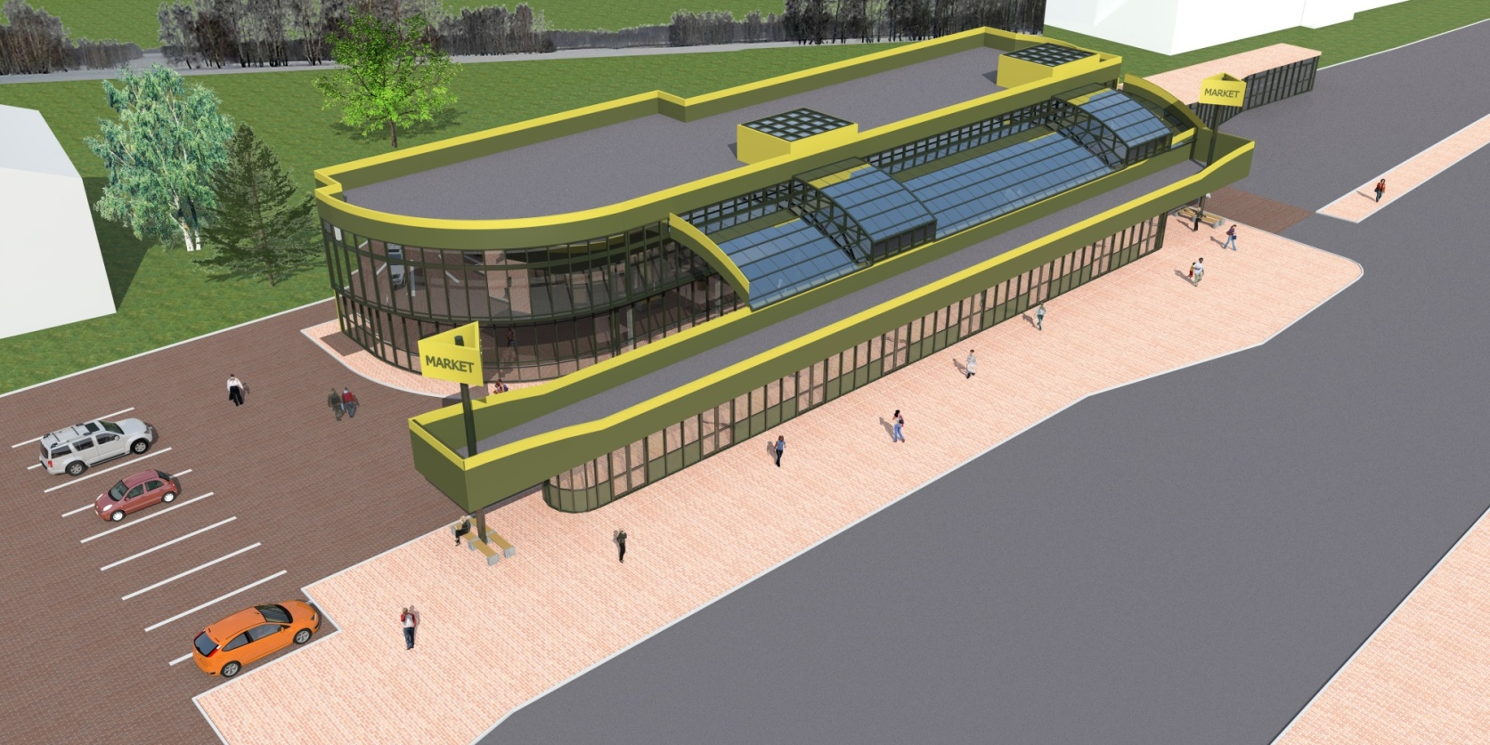
Palace of Sports Construction

Slide 42
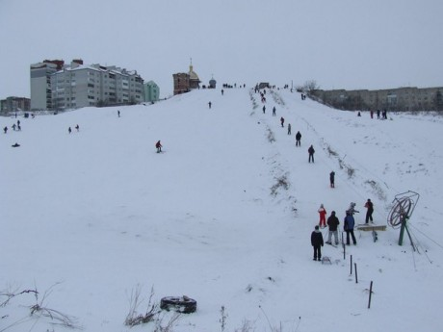
Ski Trail Construction

Slide 43
Projects in progress
1. Modernization, reconstruction and replacement of existing water supply and wastewater systems in Ternopil.
The project is being implemented in cooperation with the MBRD The project cost – 36,7 million USD
2. Modernization of existing system of central district heating of Ternopil.
The project is being implemented in cooperation with the EBRD and E5P
The project cost - 15 million Euro

Slide 44
Transport and logistics hub
The Ternopil Airport is fully equipped and ready Currently operates charter flights only Maximum take-of mass ( MTOW ) 68 tones
There are two passengers terminals:
departure terminal ( 1,070 sq.m. )
arrival terminal ( 384 sq.m. )
The current estimated population of Ternopil Oblast is 1,094 mln people, including the population of Ternopil – 217 thousand people
Distance to nearby cities:
Lviv -120 km
Khmelnytsky - 110 km
Ivano-Frankivsk - 130 km
Rivne - 130 km
Lutsk - 150 km
Chernivtsi - 170 km

Slide 45
Factors of localization of the project
The territory 164.29 hectares
Location 2 km from Ternopil
Potential passenger traffic: 100 passengers / hour,
2000 passengers / day
The ability to accommodate
aircraft: CLASS : 2,3,4; A-320,
Boeing-737-100,
Embraer-45, Douglas-9

Slide 46
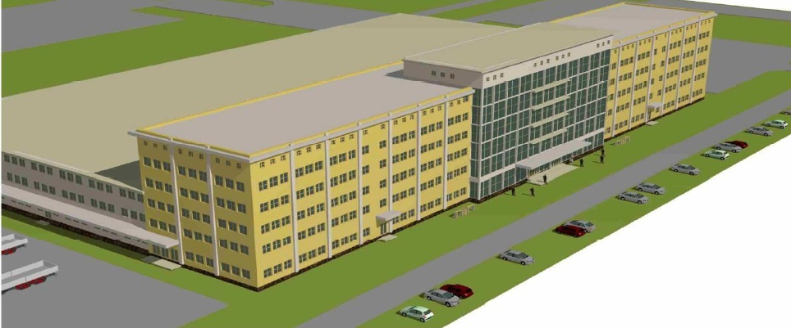
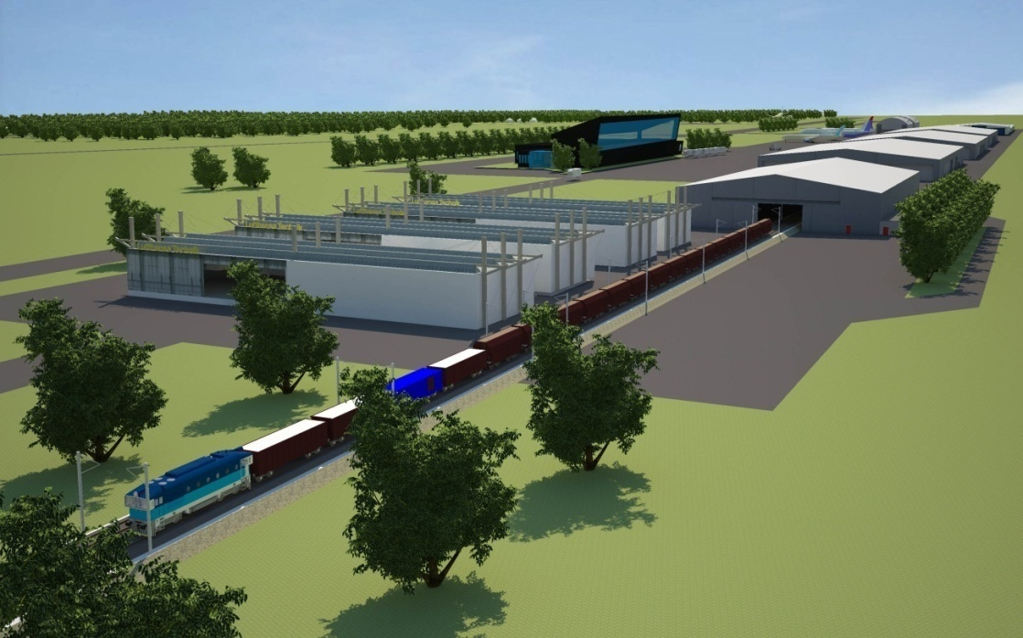
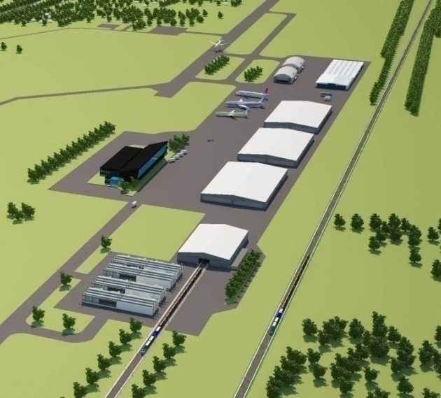

Slide 47
Waste recycling plant
City produces 100 thousand tons of solid waste annually or 400 thousand cubic meters
There’s no garbage recycling plant neither in the city nor in the region within a radius of 70-80 km
The land plot for construction is available
A factory can specialize on sorting of garbage and processing of the solid waste, as well as on energy generation
World experience shows that profitability of waste recycling plants is high, from 20% and above

Slide 48
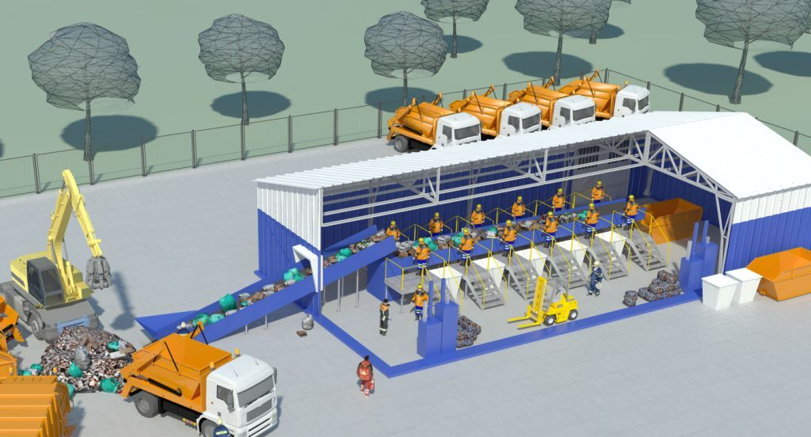
Waste recycling plant

Slide 49
Energy Efficiency and Alternative Energy
Total consumed (by all customers) in 2013:
natural gas - 250,1 mln cubic meters
electric power - 370 thousand MWh per hour
Total costs – 1 300 000 000 GRN - for generation of heating energy for heating and hot water supply
We are ready to buy this energy from a company, which produces it from alternative sources and ecological energy
Municipal Enterprise "Ternopilmiskteplokomunenergo“ has produced and released 569 677,4 Gcal of heating energy
in 2013

Slide 50
Energy Services Companies (ESCO) and Thermo-modernization
There are 90 objects of the social sphere (schools, hospitals, kindergartens , sports buildings etc.) in Ternopil and all these objects are now in the energy consumption class F
All social objects need modernization. The gas consumption in schools and kindergartens of Ternopil has decreased 25% due to the use of individual heating points during the heating season 2014-2015.
.
There are about 800 buildings constructed in 1991 which totals about 2 million square meters.

Slide 51
We invite investor who will be able to do the following
1. To provide energy audit of an object
2. To implement the project, which will ensure reduction of gas consumption in 1, 5-2 times and transition from energy consumption class F (331-450 kWh/sq.m annually) to C
3. To get profit, equal to a difference between the old norm of consumption and new reduced norm of consumption. The law will be adopted soon, which will provide legal opportunity for the investor to get such profit
Δ

Slide 52
Automated payment system for city transport
Strategic tasks of the project :
To provide the Municipal Transport with modern and multipurpose complex of passenger automatic control
Optimization of the number of the personnel and sales technology
Quality, efficiency and accessibility of services
Introduce a uniform system of cashless payments in transport
Transparent mechanisms of regulation of transport system operation

Slide 53
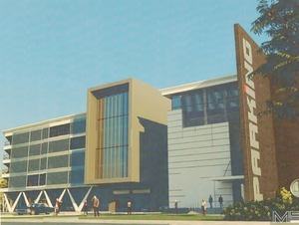
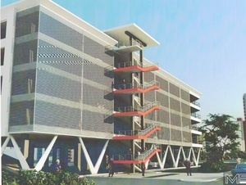
Construction of multi-storey parking lots for cars

Slide 54
Looking forward to meeting you in Ternopil!
Serhiy Nadal
Mayor of Ternopil
E-mail:serhiy.nadal@gmail.com
Tel: +38 0352 52 20 21
Yuriy Deyneka
Chief of City Strategic Development Department
E-mail: deyneka.yuriy@gmail.com
Mobile: +38 352 25 37 80
www.rada.te.ua

Slide 55
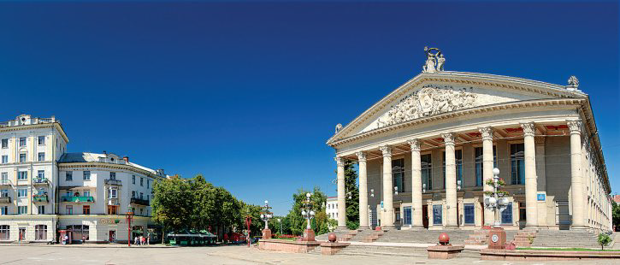
Thank you for your attention!
Welcome to Ternopil

